Slide 1

Support Vector Machine

Slide 2
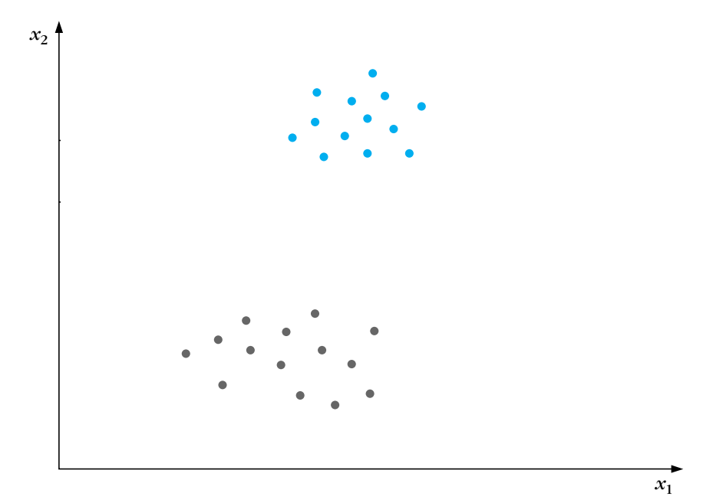
Which classifier would you choose ?
Criterial of the optimal classifier ?
Notes:
Ask student which line they choose and why?
Based on their answers what criterial we want in the classifier ?

Slide 3
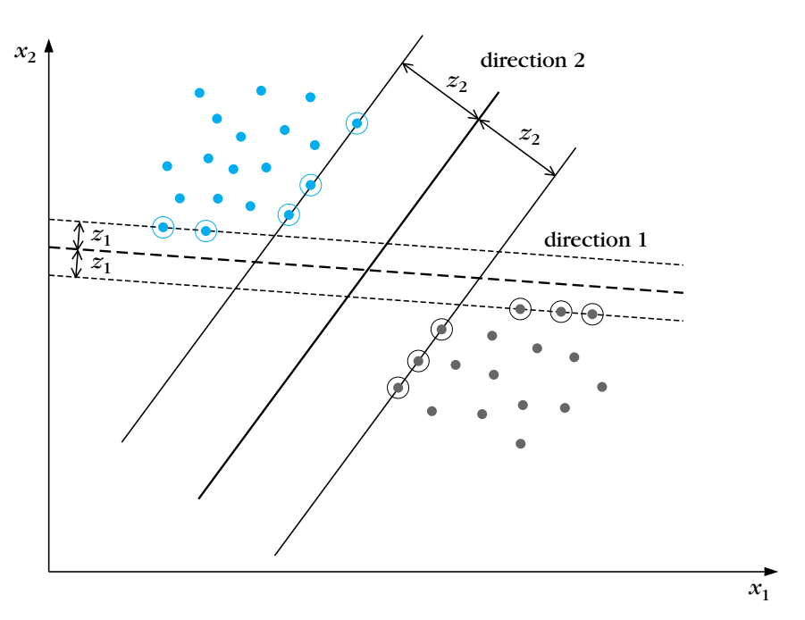
Margins and support vectors
Notes:
Draw and explain the margin and support vectors and when we know the support vectors points ( that lay in the boundary of the margin) we can get reed of the whole points except the only two at the boundary.

Slide 4
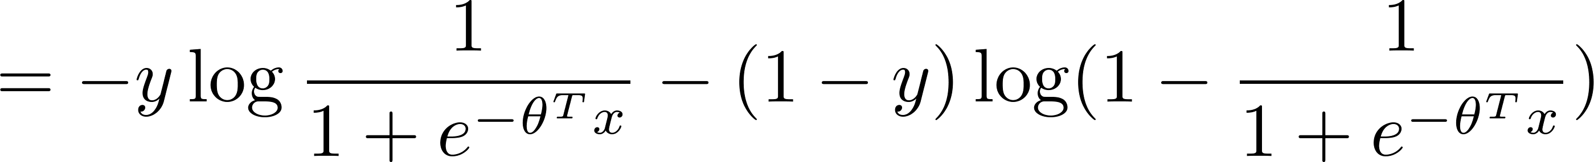

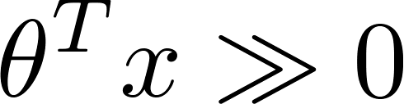
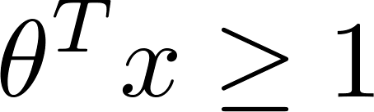

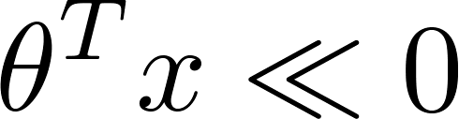
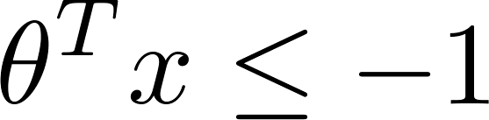
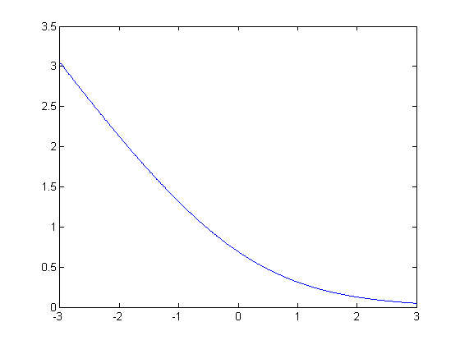
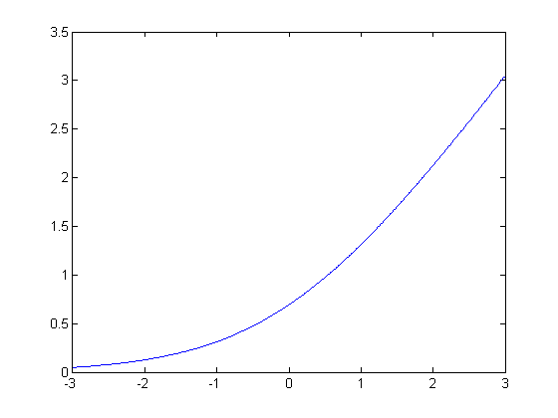




Recall logistic regression cost function
Cost of example:
If (want ):
If (want ):
$$z$$
$$z$$
Notes:
Draw the SVM cost as a zero when the value is > 1 or <-1 and y=x line other wise.

Slide 5
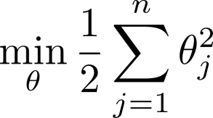
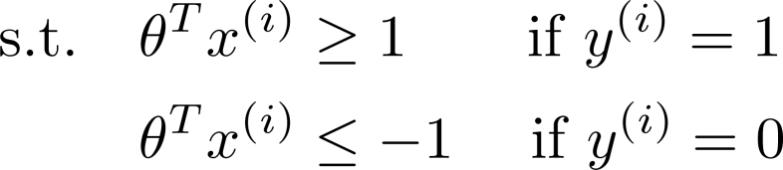

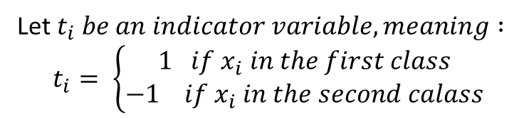
The mathematics behind large margin classification
SVM Decision Boundary
Let $t_{i} be an indicator variable, meaning :$
$$t_{i}= \left\{\begin{aligned}1 if x_{i} in the first class \\ −1 if x_{i} in the second calass\end{aligned}\right.$$
s.t. $t_{i} \left(θ^{T}x^{\left(i\right)}\right)≥1$

Slide 6
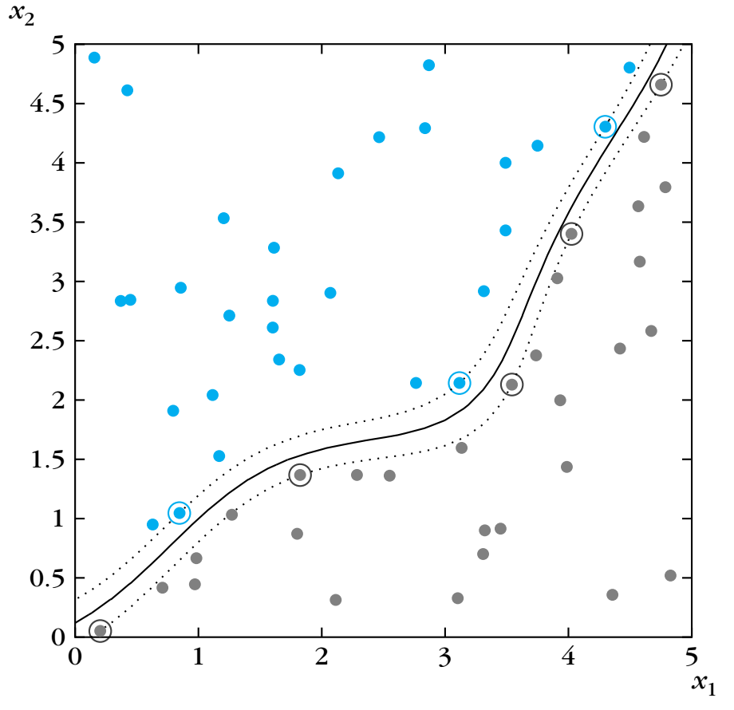

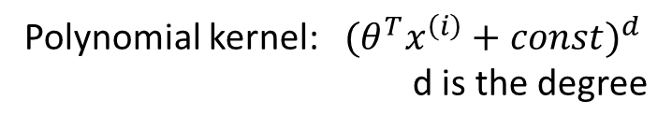
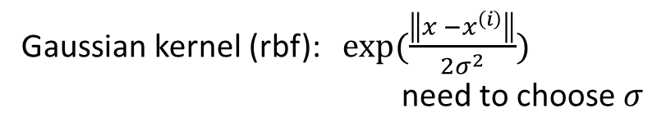

What if the data is not linearly separable ?
We can make a non linear transformation for the data to other space where it is linearly separable.
Kernels
Linear kernel (no kernel ): $θ^{T}x^{\left(i\right)}$
Gaussian kernel (rbf): $\exp{(\frac{\left\|x −x^{\left(i\right)}\right\|}{2σ^{2}})}$
need to choose $σ$
Polynomial kernel: ${{(θ}^{T}x^{\left(i\right)}+const)}^{d}$
d is the degree
String kernel, chi-square kernel, histogram intersection kernel, …
Not all similarity functions make valid kernels.
(Need to satisfy technical condition called “Mercer’s Theorem” to make sure SVM packages’ optimizations run correctly, and do not diverge).

Slide 7
SVM

Slide 8
K Nearest Neighbour

Slide 9
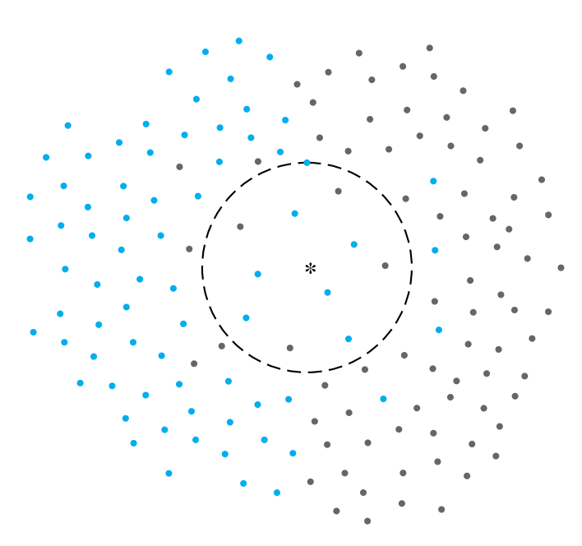
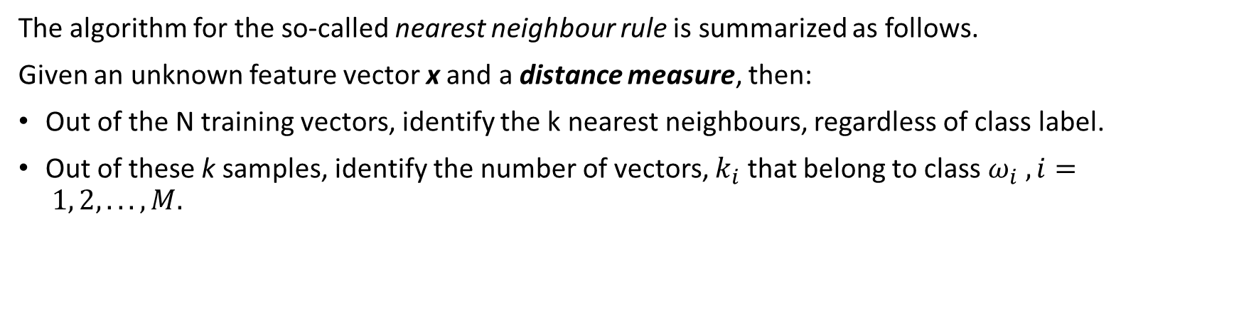
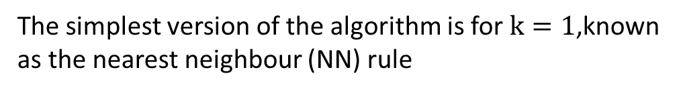
KNN
The algorithm for the so-called nearest neighbour rule is summarized as follows.
Given an unknown feature vector x and a distance measure, then:
Out of the N training vectors, identify the k nearest neighbours, regardless of class label.
Out of these k samples, identify the number of vectors, $k_{i}$ that belong to class $ω_{i} , i= 1, 2, . . . , M.$
The simplest version of the algorithm is for $k=1$,known as the nearest neighbour (NN) rule

Slide 10
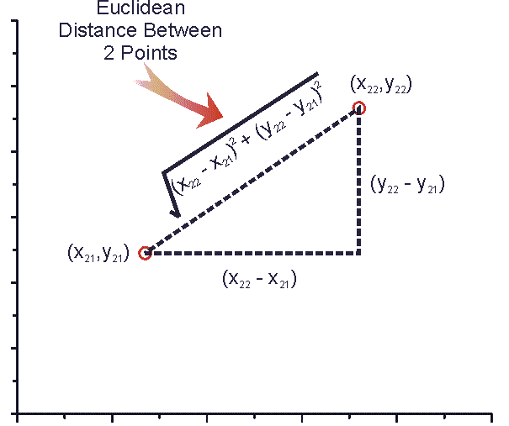
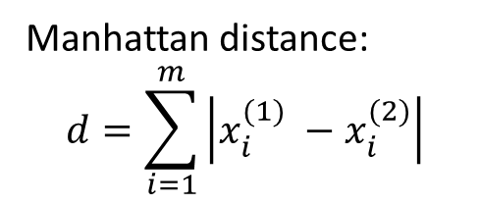
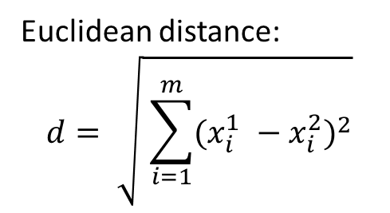
Distance (similarity) measure
Euclidean distance:
$$d= \sqrt{ \sum_{i=1}^{m}{{(x_{i}^{1} −x_{i}^{2})}^{2}}}$$
Manhattan distance:
$$d=\sum_{i=1}^{m}{\left|x_{i}^{(1)} −x_{i}^{(2)}\right|}$$

Slide 11
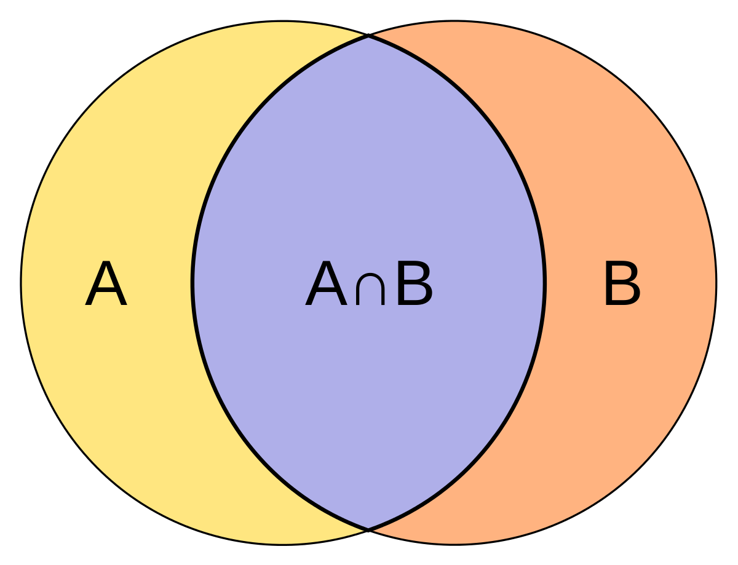
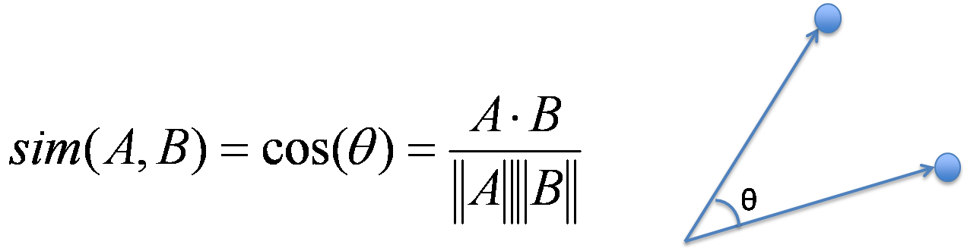
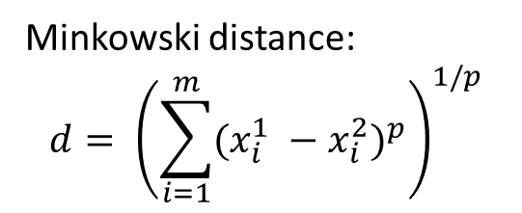
Distance (similarity) measure
Minkowski distance:
$$d= {\left(\sum_{i=1}^{m}{{(x_{i}^{1} −x_{i}^{2})}^{p}}\right)}^{1/p}$$
Jaccard similarity
Cosine similarity:

Slide 12

Implementation

